Slide 1
Big Data
Wiselin Mathuram

Slide 2
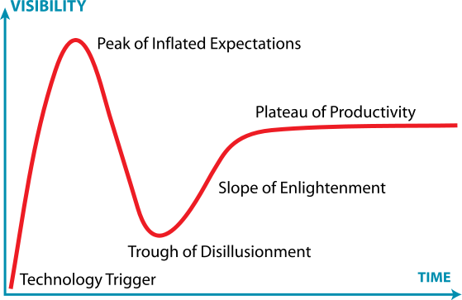
Gartner Hype Cycle

Slide 3
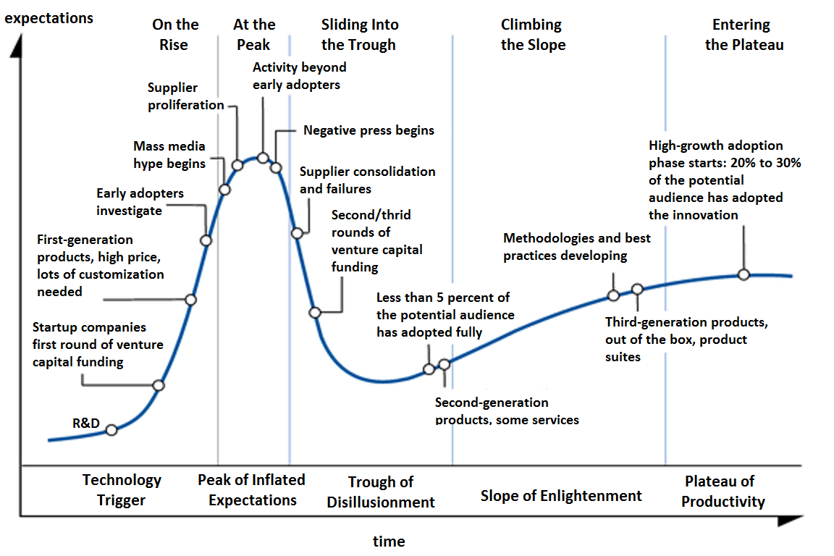
Gartner Hype Cycle

Slide 4
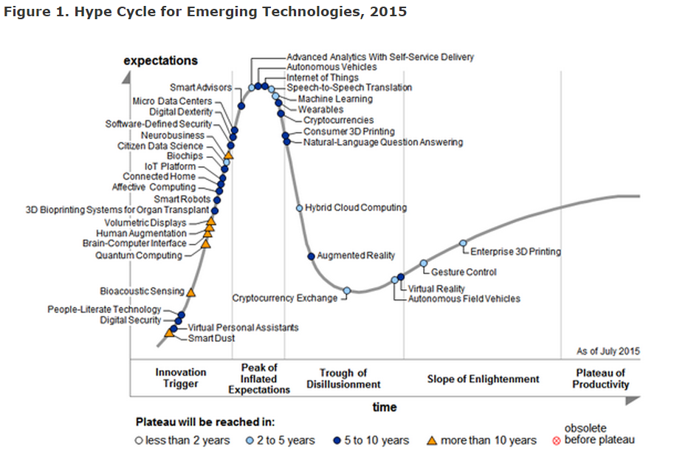
Hype Cycle 2015

Slide 5
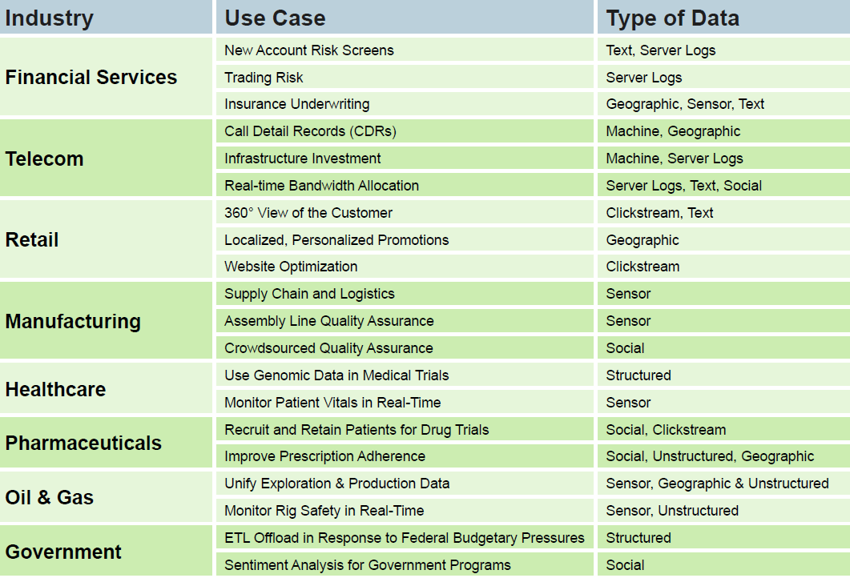
What is Big Data ? (Ex of click steam)

Slide 6

Data Lake
A data lake is a storage repository that holds a vast amount of raw data in its native format until it is needed

Slide 7
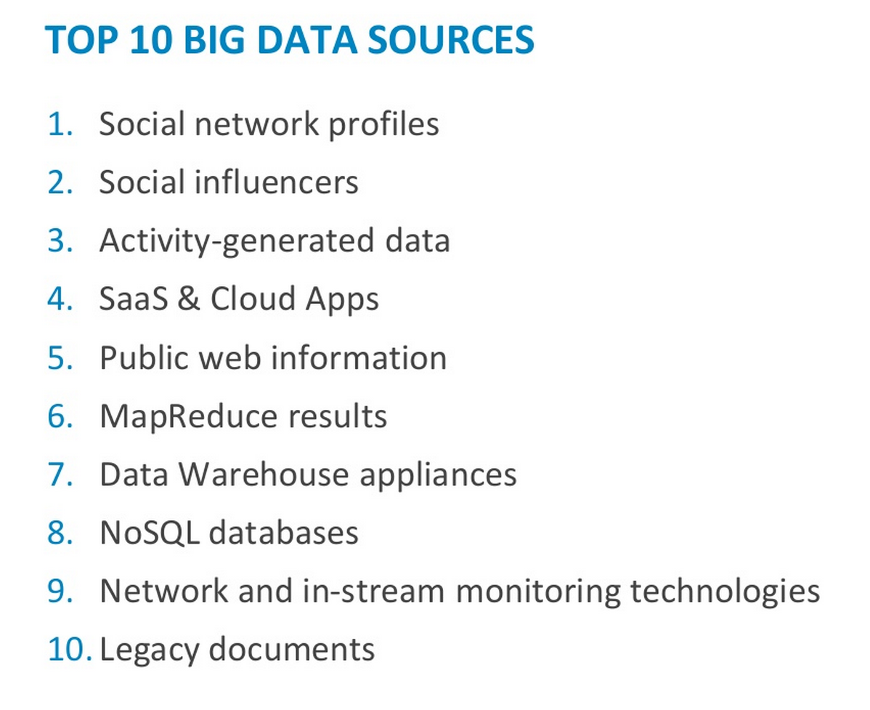

Slide 8
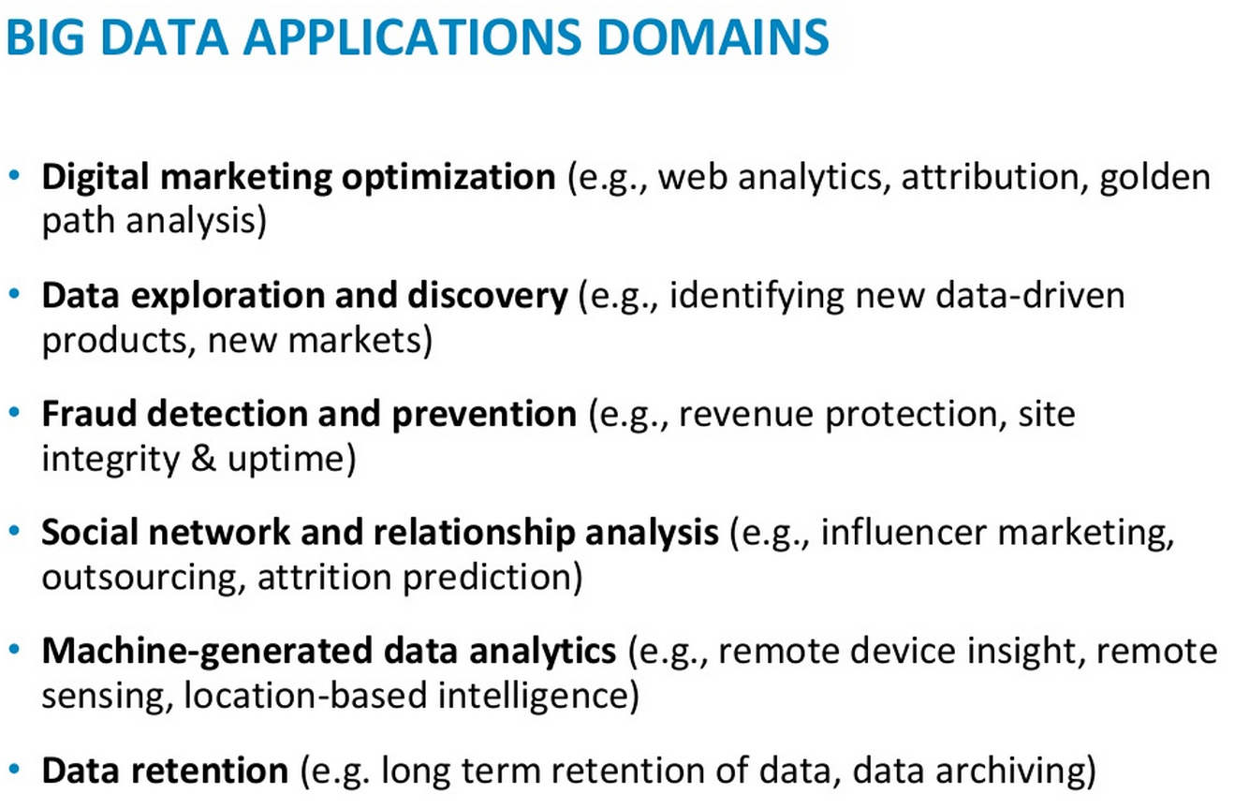

Slide 9
Types of Big Data Analysis
Descriptive
Predictive
Prescriptive
Please read this link

Slide 10
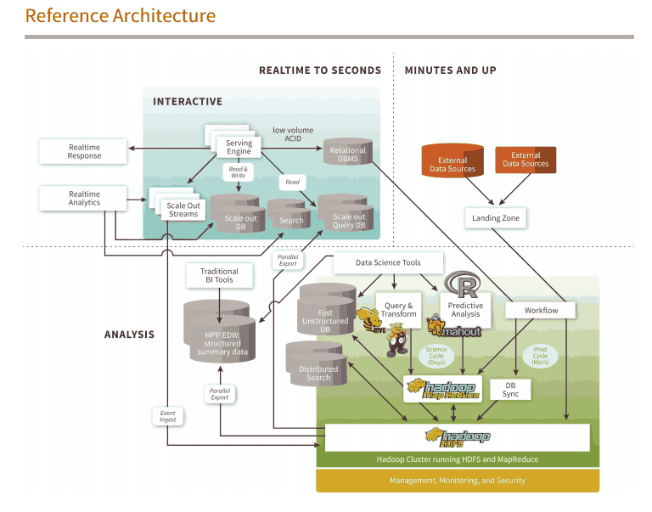
Big Data Architecture (link)

Slide 11
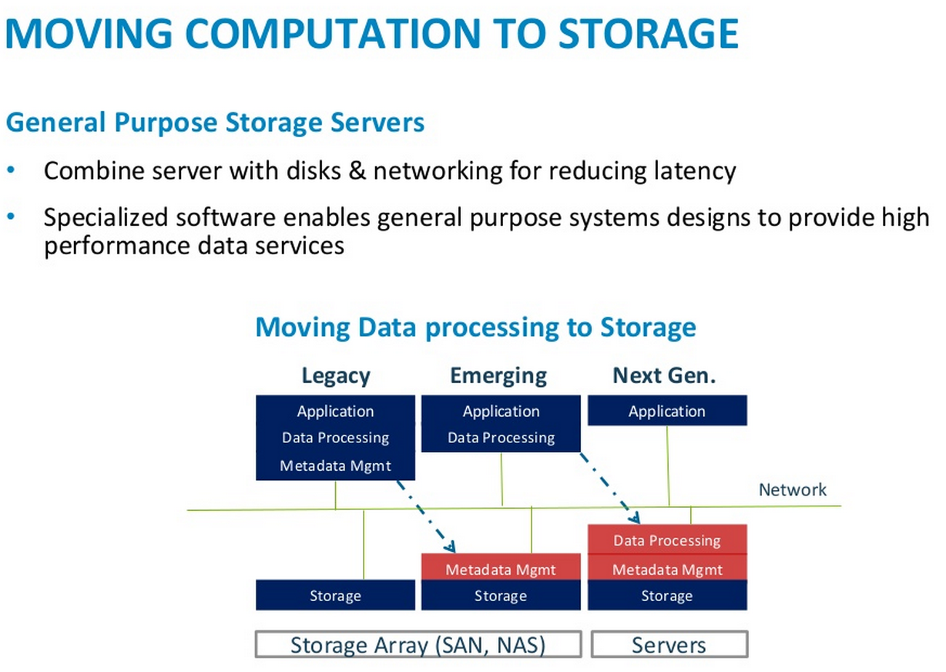

Slide 12
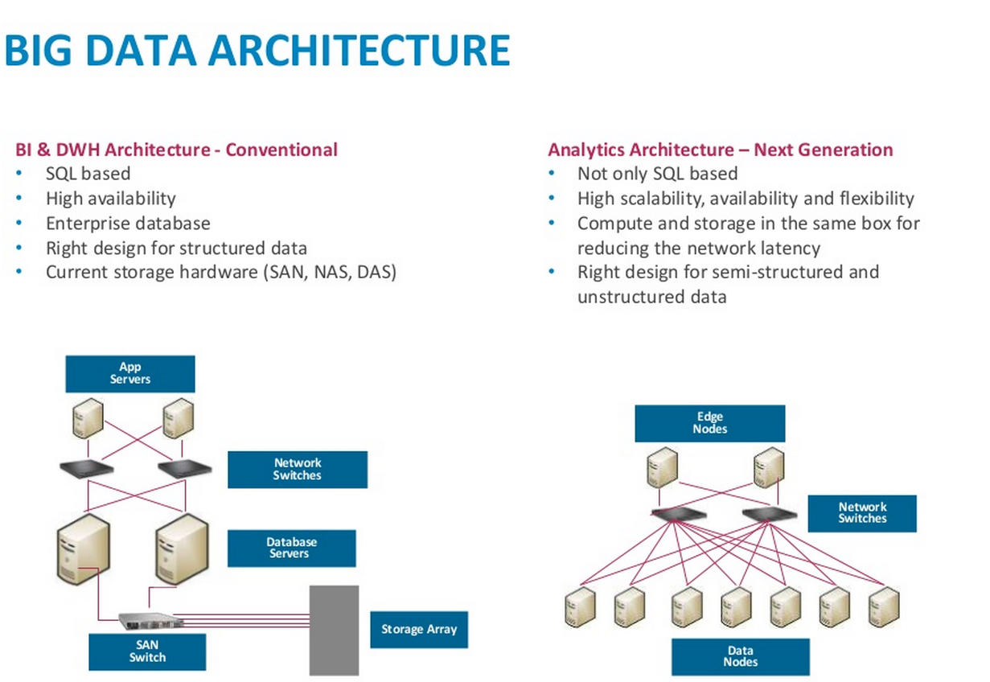

Slide 13
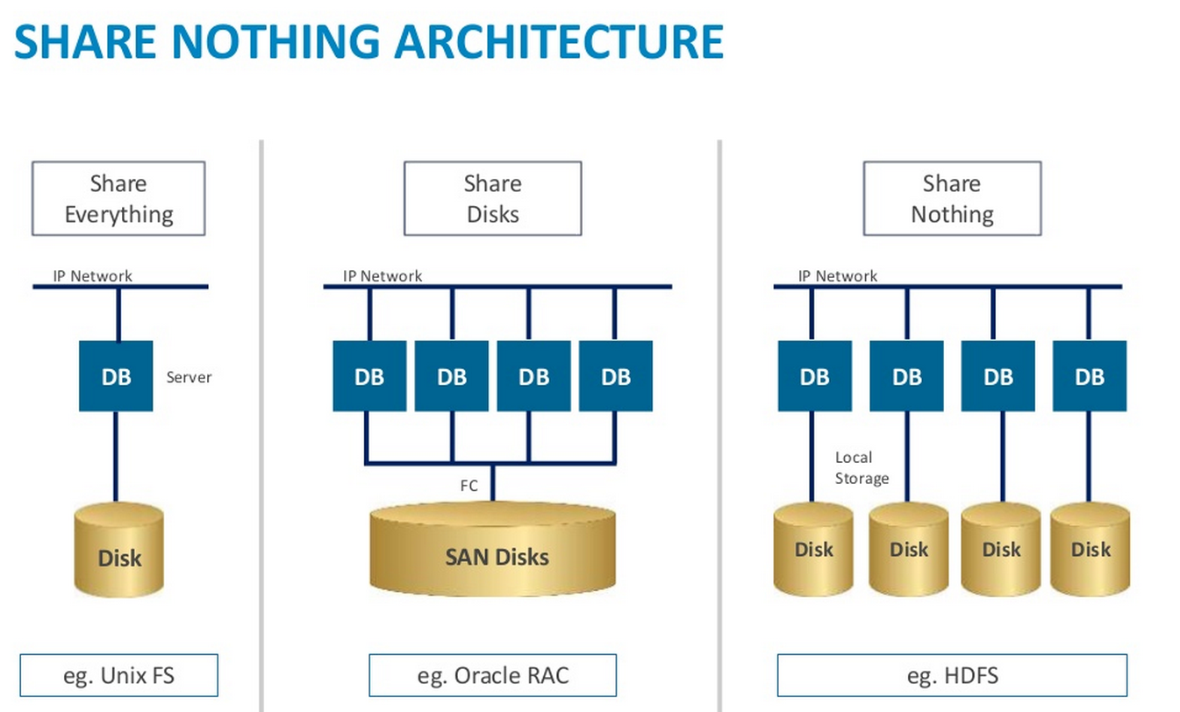

Slide 14


Slide 15
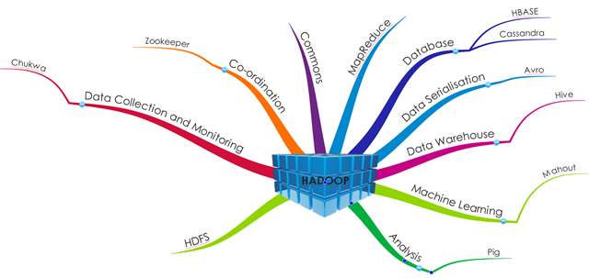
Hadoop (Cont..)

Slide 16
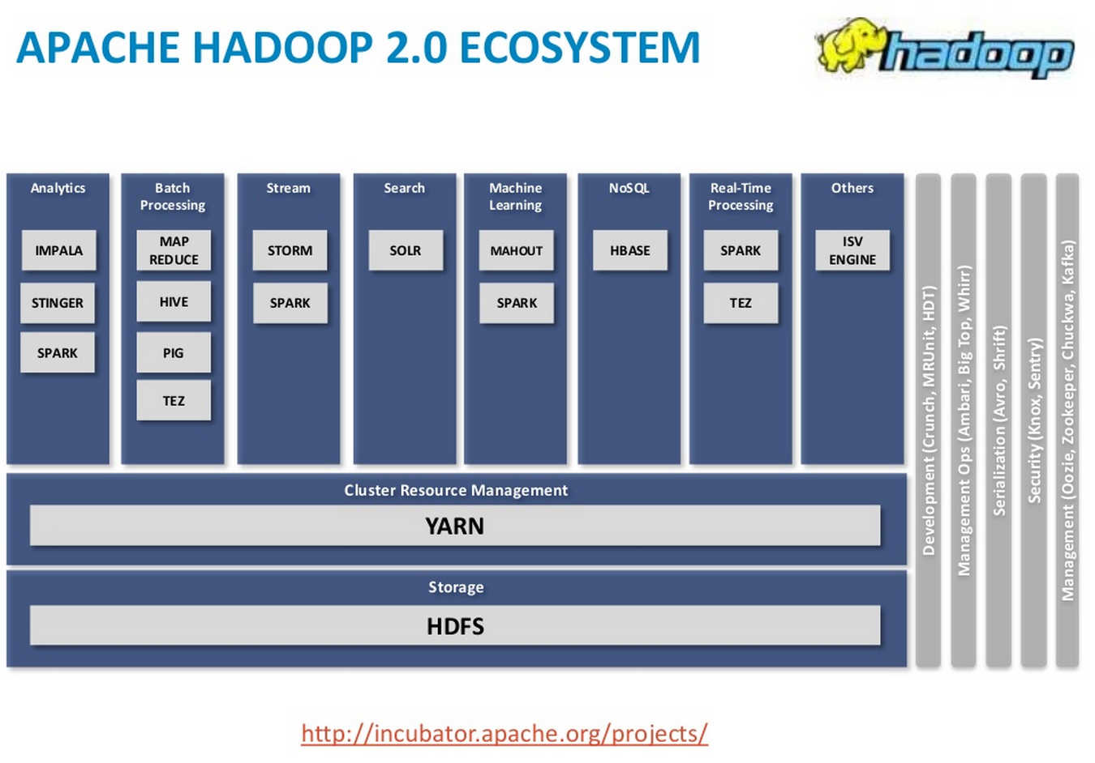

Slide 17
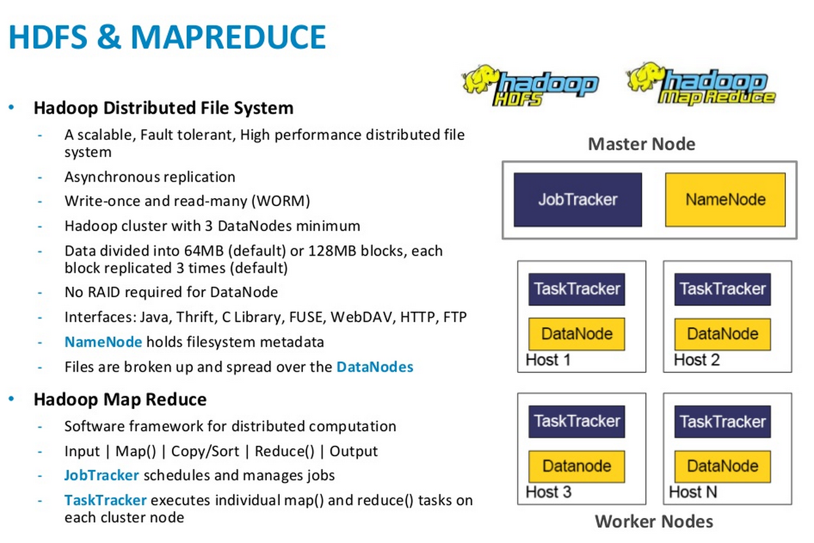

Slide 18
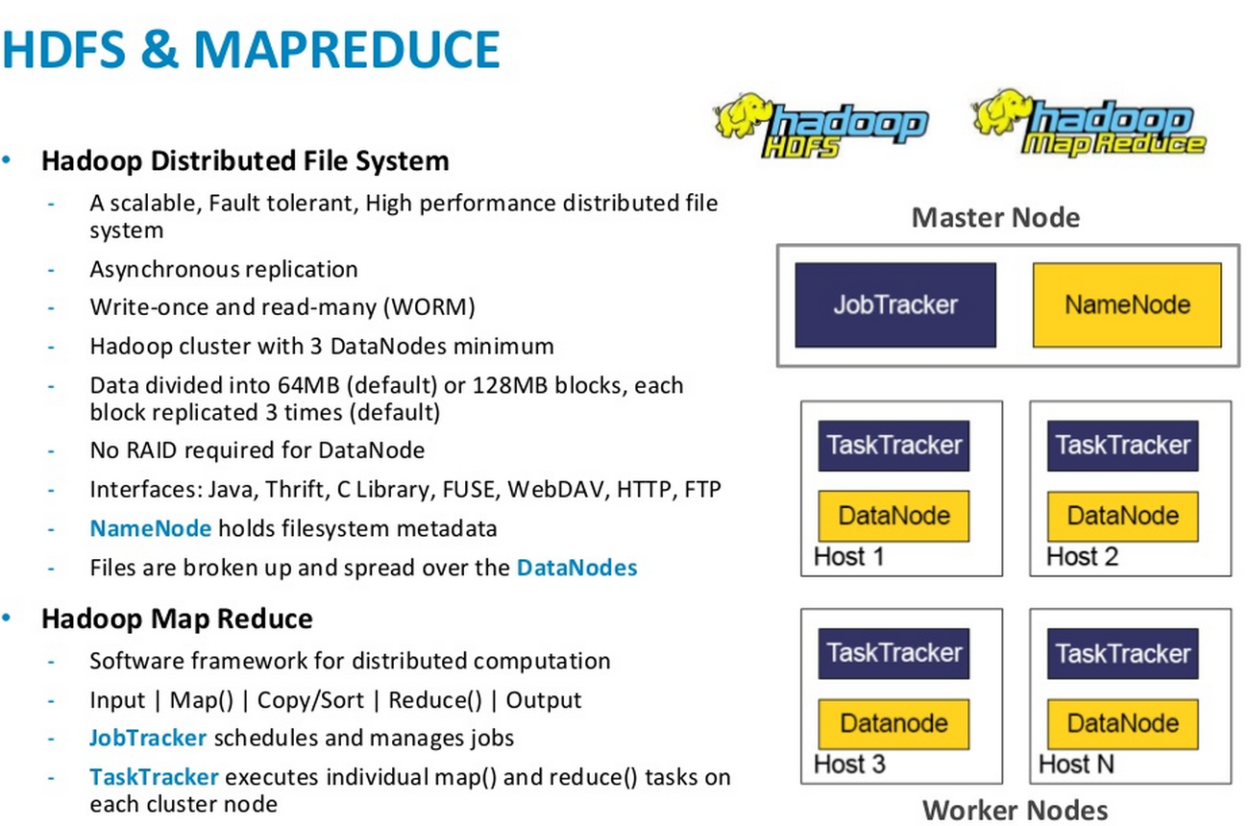

Slide 19
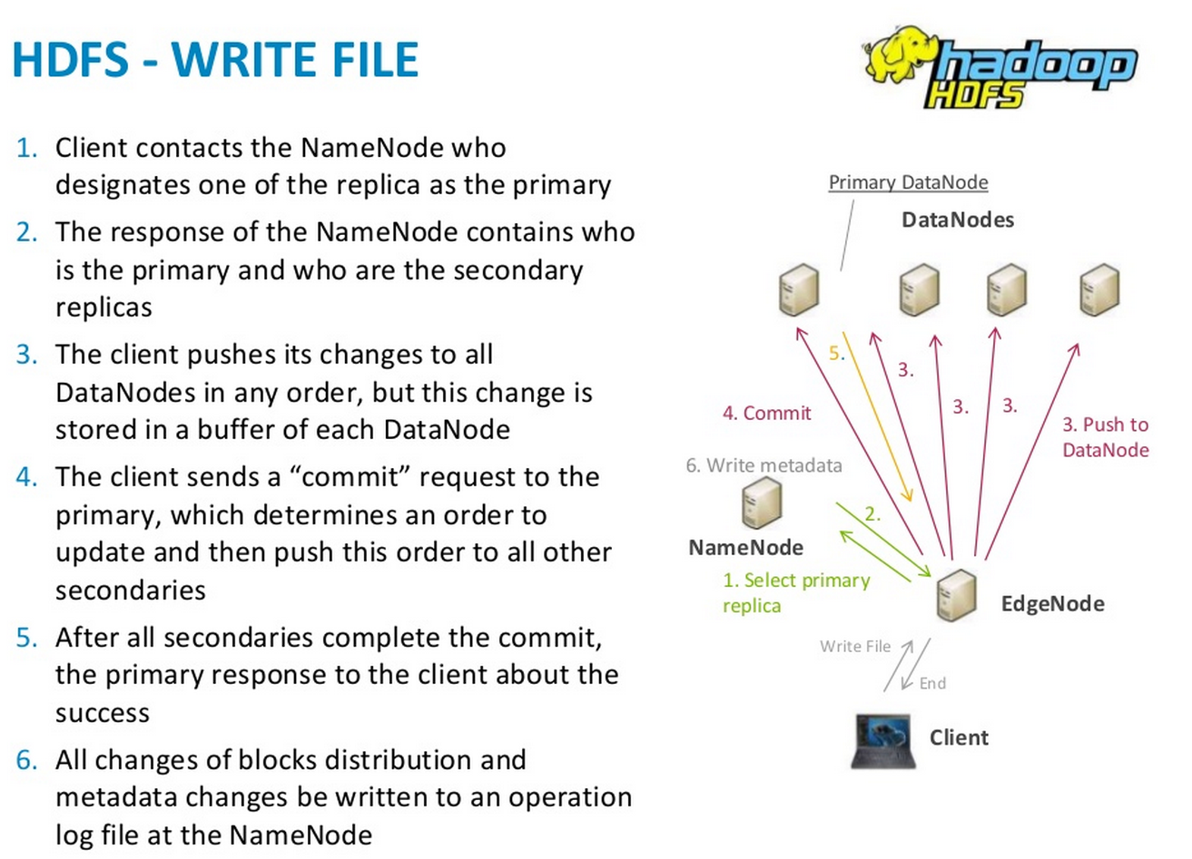

Slide 20
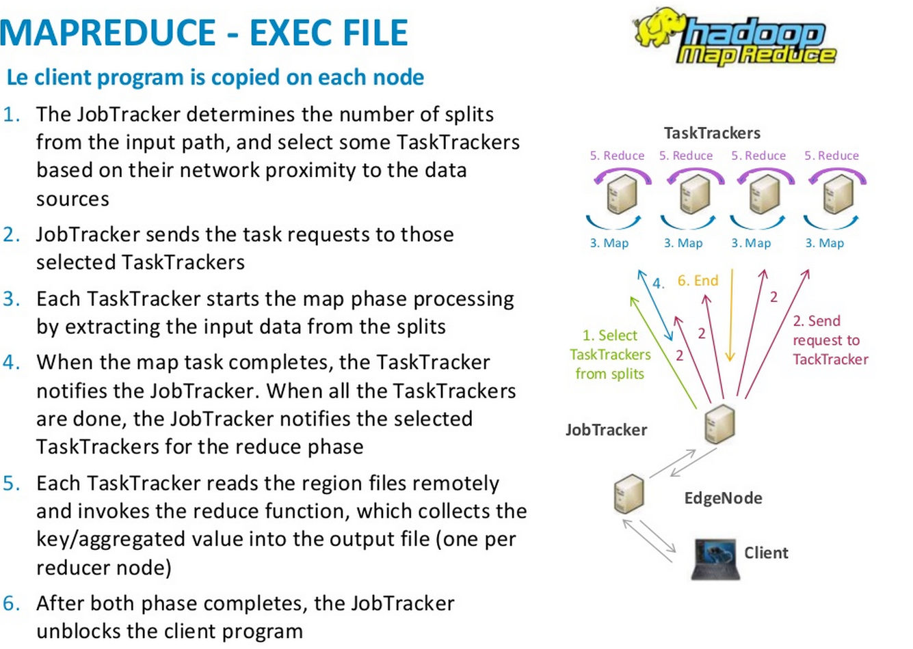

Slide 21
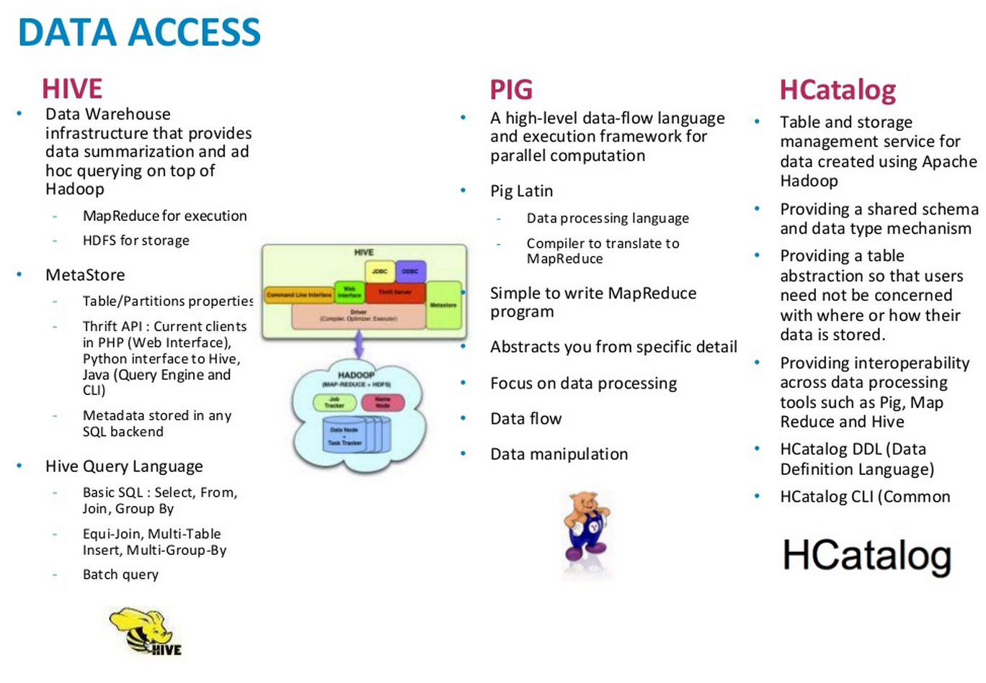

Slide 22
Cybersecurity Your View?
Government
Regulations
Internal
Policies
Reputation
Nation
States
Malware
Revenue
Loss
NIST
Policy
Customer
Property
Destruction
DOD
8570
Anonymous
Intellectual
Property
Theft
PII Theft
Hackers
Embarrassment
Education
Advanced
Persistent
Threat
NERC
CIP
SAM 8500
Partners
Protecting
National
Security
Money
Theft
Insider
Threat
MS-ISAC
DISA
STIG
Espionage
Notes:
Is this your view? Are you overwhelmed with all things cyber? You are not alone… .

Slide 23


AGILITY
FLEXIBITY
AUTOMATION
AGILITY
FLEXIBITY
AUTOMATION
AGILITY
FLEXIBITY
AUTOMATION
CONSISTENCY
VISIBILITY
EFFICIENCY
CONSISTENCY
VISIBILITY
EFFICIENCY
CONSISTENCY
VISIBILITY
EFFICIENCY
CONSOLIDATION
COST REDUCTION
ELASTIC
CONSOLIDATION
COST REDUCTION
ELASTIC
CONSOLIDATION
COST REDUCTION
ELASTIC
Physical
Virtual
Cloud
AGILITY
FLEXIBITY
AUTOMATION
AGILITY
FLEXIBITY
AUTOMATION
AGILITY
FLEXIBITY
AUTOMATION
CONSISTENCY
VISIBILITY
EFFICIENCY
CONSISTENCY
VISIBILITY
EFFICIENCY
CONSISTENCY
VISIBILITY
EFFICIENCY
CONSOLIDATION
COST REDUCTION
ELASTIC
CONSOLIDATION
COST REDUCTION
ELASTIC
CONSOLIDATION
COST REDUCTION
ELASTIC
DC | CLOUD TRANSITION
# ! %
Extending security posture
Unifying the network services
Securing multi-tenancy designs
Appliance
Notes:
This customer centric market has caused the traditional data center to move to virtual and now cloud based. We need to now extend our security posture beyond what was once a fixed perimeter to the new dynamic perimeter.

Slide 24












IT Megatrends are creating the “Any to Any” problem
Infrastructure
public
Any Device, Any Cloud
Apps / Services
hybrid
tenants
Workloads
private
Endpoint Proliferation
Blending of Personal
& Business Use
Access Assets through
Multiple Medians
Services Reside
In Many Clouds
Notes:
These trends have created an any to any problem. The proliferation of endpoints and the blurred lines between work and personal life have made securing our any device to any cloud very complex.

Slide 25
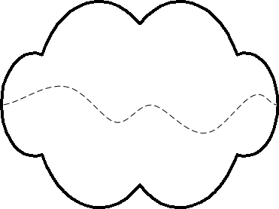



URL, uniform resource locator
http://som.csudh.edu/fac/lpress/shortbio.htm
request
page
Client
Server
Notes:
To retrieve a page from a Web site, you type its uniform resource locator or URL into the box at the top of the browser and hit enter. The browser then retrieves the page from the server and displays it. URL is just a fancy way to say the Web address of the page.
In this example, the file that is displayed is a short text document with a brief professional biography of me.

Slide 26
Four parts of the URL
http://som.csudh.edu/fac/lpress/shortbio.htm
http://som.csudh.edu/fac/lpress/shortbio.htm
http://som.csudh.edu/fac/lpress/shortbio.htm
http://som.csudh.edu/fac/lpress/shortbio.htm
Notes:
If you look at URLs, you see that they can be broken down into four parts. Note that some of the parts may be omitted at times, and we will talk about that later.

Slide 27
http://
http://som.csudh.edu/fac/lpress/shortbio.htm
Notes:
The URL prefix “http://” indicates that this is the locator for a Web document that should be retrieved and displayed. It turns out that Web browsers can also function as clients for other services like file transfer, but that is seldom done. For that reason, one can leave the “http://” off and most browsers will plug it in for you.

Slide 28
The domain name
http://som.csudh.edu/fac/lpress/shortbio.htm
Notes:
The next part of our example URL reads “som.csudh.edu”. That is the domain name of the server. Domain name is another fancy geek word that means the name of the computer the server program is running on. We will say more about domain names in another presentation. For now, it is enough to say that the domain name identifies a unique computer on the Internet.

Slide 29
The directory
http://som.csudh.edu/fac/lpress/shortbio.htm
root
staff
fac
admin
*
jsmith
. . .
jdoe
lpress
Notes:
The next part of the URL is the directory or folder containing the page we are looking for. Every computer has many files in storage. We would quickly become confused in trying to locate a single file in a list of say 100,000 names. For that reason, we organize our storage into hierarchical directories, sub-directories, sub-sub-directories and so forth.
Here we have three sub-directories – for staff, faculty and administrators. Since I am a faculty member, my lpress directory is a subdirectory of the fac directory. Each faculty member – jsmith, jdoe, and the rest have directories in the fac directory.

Slide 30
The file name
http://som.csudh.edu/fac/lpress/shortbio.htm
root
staff
fac
admin
jsmith
. . .
jdoe
lpress
shortbio.htm
Notes:
The final part of the URL is the name of the file we wish to retrieve, in this case “shortbio.htm.” Since shortbio.htm is in the lpress directory, the Web server will send that file back to the client, which will display it. The user will read my short biography.

Slide 31
URLs may be shortened
http://www.csudh.edu/studentaffairs/financialaid/faq.shtml#apply_for_scholarships
http://bit.ly/djeREW
(I shortened the URL using the service at http://bit.ly. There are others that do the same thing.)
Notes:
Let’s look at a couple more things concerning URLs.
For a start, you can save space by shortening a URL. Both of the links shown here are to the same page. There are many URL shortening services on the Internet. I used one called bit.ly for this example.

Slide 32
Know the source of a shortened URL
http://bit.ly/9dLHk5
Notes:
Shortened URLs hide the actual domain name, so you cannot tell where they link to by looking at them. Click this link to see why you should only go to shortened URLs from trusted sources.

Slide 33
You can delete the http://
som.csudh.edu/fac/lpress/shortbio.htm
Notes:
If you delete the http://, the client will assume the message is for a Web server and request the page as if the http:// had been included.

Slide 34
What happens if you delete the file name?
http://bpastudio.csudh.edu/fac/lpress/
The Web server will look for a file with a default name, which is specified by the server administrator.
Traditional default names are index.htm, Index.html, default.htm, and default.html.
Notes:
If you delete the file name, the Web server will look for a file with a default name, which is specified by the server administrator.
Traditional default names are index.htm, Index.html, default.htm, and default.html.

Slide 35
URL summary
http://som.csudh.edu/fac/lpress/shortbio.htm
This request is for a Web (http) server
The server program is running on a computer with the domain name som.csudh.edu
Look in a subdirectory called fac/lpress
If there is a file called shortbio.htm, send it back to the client to be displayed; if not, send an error message back to the client
Domain name = the unique name of a computer on the Internet
Notes:
Here we summarize the meaning of the four parts of a URL. In addition to learning about the parts of a URL, we saw that they may be shortened using a service like Bit.ly and that some parts of the URL were optional.

Slide 36
What is after the ?
http://html.net/page.php?id=1254
Why is there a question mark after the page name?
The answer is that the characters after the question mark are an HTTP query string. An HTTP query string can contain both variables and their values. In the example above, the HTTP query string contains a variable named "id", with the value "1254".

Slide 37
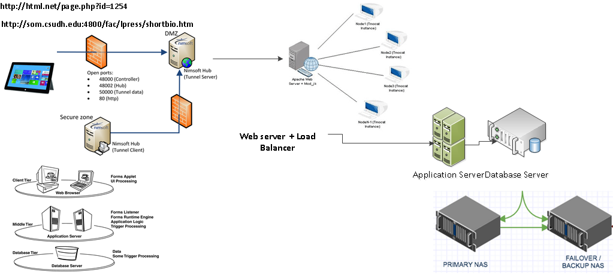
Simple Architecture diagram
Intranet Vs Extranet
DMZ
Firewall
Web Server
Application Server
Load Balancer
Database Server
NAS
Failover/Backup

Slide 38
Regression Analysis
What is Regression Analysis
In statistics, regression analysis is a statistical process for estimating the relationships among variables.
It includes many techniques for modeling and analyzing several variables, when the focus is on the relationship between a dependent variable and one or more independent variables (or 'predictors').
It is used for Predictive Analysis
Predictive analytics encompasses a variety of statistical techniques from modeling, machine learning, and data mining that analyze current and historical facts to make predictions about future, or otherwise unknown, events.

Slide 39
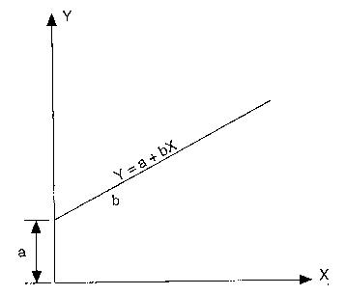
Regression Analysis & R
Regression means dependence and involves estimating the value of a dependent variable Y, from an independent variable X. In simple regression, only one independent variable is used, whereas* multiple regression two or more independent variables are involved. The simple regression takes the following form.
Y = a + bX
Where
Y — dependent variable
X — independent variable
a — intercept
b — slope (trend)
These are represented in the following graph.
Graph showing simple regression
The model for multiple linear regressions is shown below.
Y = a +b₁X₁+ b₂X₂+ b₃X₃+ b_{i}X_{i}+ …+ b_{n}X_{n}
Where
Y — dependent variable
X_{i} — ith independent variable
a — intercept
b_{i} — slope of the independent variable Xi

Slide 40
Class R Example for multiple Linear Equation
R Code ( Example runs a model where Y = Ozone and X1 = Temp and X2 = Wind)
# sets the working directory
setwd("C:/Users/wmathura/Documents")
# Reads the data into R
mydata<-read.csv("Ozone_data.csv")
# Runs a Regression model and gives the summary output
summary(lm(Ozone ~ Temp+Wind, data = mydata))
Y = b₁X₁+ b₂X₂+ a
1. Ozone = 1.8 Temp – 3.3 Wind – 67
## Call: ## lm(formula = Ozone ~ Temp + Wind, data = mydata) ## ## Residuals: ## Min 1Q Median 3Q Max ## -42.156 -13.216 -3.123 10.598 98.492 ## ## Coefficients: ## Estimate Std. Error t value Pr(>|t|) ## (Intercept) -67.3220 23.6210 -2.850 0.00524 ** ## Temp 1.8276 0.2506 7.294 5.29e-11 *** ## Wind -3.2948 0.6711 -4.909 3.26e-06 *** ## --- ## Signif. codes: 0 '***' 0.001 '**' 0.01 '*' 0.05 '.' 0.1 ' ' 1 ## ## Residual standard error: 21.73 on 108 degrees of freedom ## Multiple R-squared: 0.5814, Adjusted R-squared: 0.5736 ## F-statistic: 74.99 on 2 and 108 DF, p-value: < 2.2e-16
The value r² is a fraction between 0.0 and 1.0, and has no units. An r² value of 0.0 means that knowing X does not help you predict Y. There is no linear relationship between X and Y, and the best-fit line is a horizontal line going through the mean of all Y values. When r² equals 1.0, all points lie exactly on a straight line with no scatter. Knowing X lets you predict Y perfectly.
2. Example r² value =0.58
3. Sign of the co-efficient determines proportionality value determines magnitude
Ozone is Directly proportional to Temp
Ozone is Indirectly proportional to Wind
& Wind impacts more than Temp

Slide 41
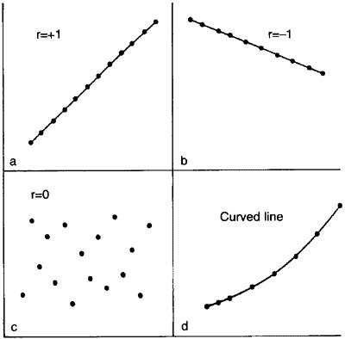
Correlation
Correlation and regression
The word correlation is used in everyday life to denote some form of association. We might say that we have noticed a correlation between foggy days and attacks of wheeziness. However, in statistical terms we use correlation to denote association between two quantitative variables. We also assume that the association is linear, that one variable increases or decreases a fixed amount for a unit increase or decrease in the other.
Correlation coefficient
The degree of association is measured by a correlation coefficient, denoted by r. It is sometimes called Pearson's correlation coefficient after its originator and is a measure of linear association. If a curved line is needed to express the relationship, other and more complicated measures of the correlation must be used.
The correlation coefficient is measured on a scale that varies from + 1 through 0 to - 1. Complete correlation between two variables is expressed by either + 1 or -1. When one variable increases as the other increases the correlation is positive; when one decreases as the other increases it is negative. Complete absence of correlation is represented by 0. Figure 11.1 gives some graphical representations of correlation.

Slide 42
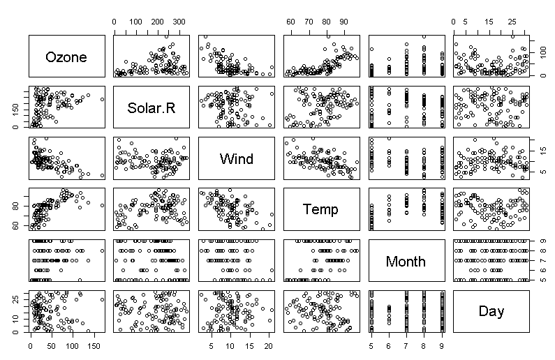
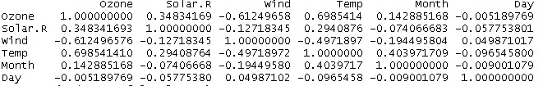
How to calculate Correlation in R
R Code for calculation Correlation
# draws a correlation plot
pairs(mydata)
# calculates the Pearson's correlation coefficient
cor(mydata)
R output

Slide 43
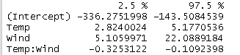
Confidence Interval
R Code:
model1=lm(Ozone ~ Temp+Wind+Temp*Wind, data = mydata)
confint(model1,conf.level=0.95)
R Output
Summary of Regression Analysis is to fit a model with R2 value = 1

Slide 44
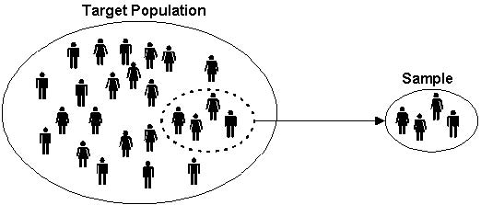
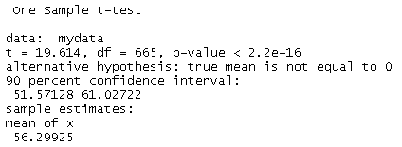
Statistical Inference of population
Sample Vs Population
How to make inference on a population based on sample
R Code:
Question: Based on the value of ozone sample can we determine with 90% confidence what will be the value of population
t.test(mydata,conf.level=0.90)

Slide 45
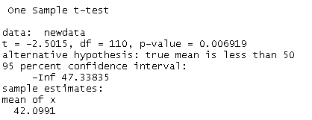
Hypothesis Testing
Hypothesis testing is an essential procedure in statistics. A hypothesis test evaluates two mutually exclusive statements about a population to determine which statement is best supported by the sample data.
Null Hypotheis H0 : Value of Ozone in population is > or = to 50
Alternate Hypotheis Ha: Value of Ozone in population in < 50
R Code
# just separating Ozone data from the data sheet
newdata <- mydata[c(1)]
# Applying T test
t.test(newdata,alternative = "less", mu= 50)
Alpha = 1- confidence percentage (example 1-0.95 =0.05
if p < alpha then reject null hypothesis
So in our example since p value is < alpha we have to reject null hypothesis
Which means Value of Ozone in population is Less than 50

